Slide 1
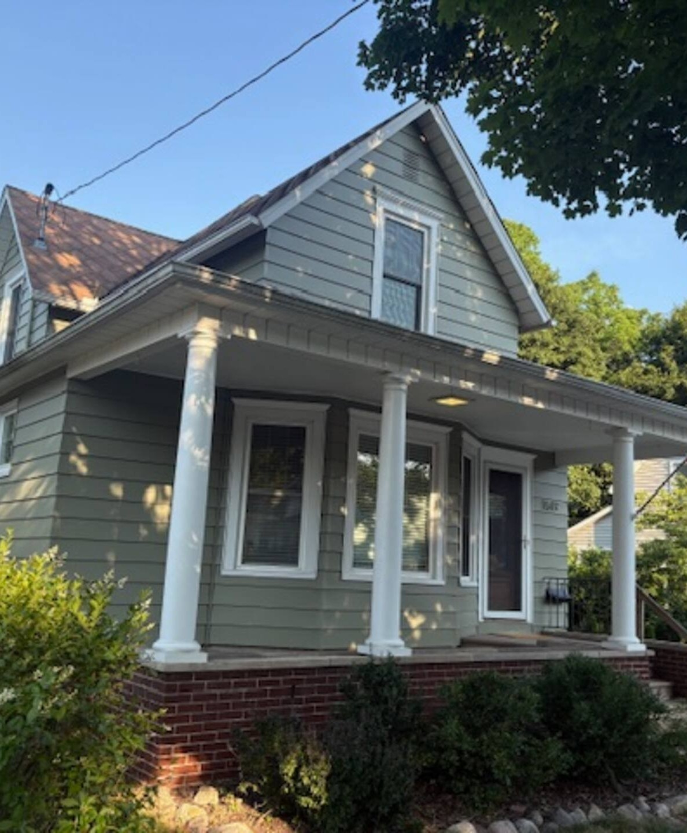

INSURANCE HOUSING · SOUTHWEST MICHIGAN
Five furnished homes.
One local number.
Call or text 269-759-8524
hollyhockproperties.com
Notes:
Open: we are the local housing desk, not a hotel block. Five private homes already in inventory in St. Joseph and South Haven. Number is 269-759-8524.

Slide 2

THE 20-SECOND PITCH
What to say when an adjuster picks up.
“Hollyhock is the local furnished-housing desk for St. Joseph and South Haven claims. We already hold five private homes — live on Furnished Finder — from $2,950 a month. Two-bedrooms at Willa, Kingsley, and Harborside; four-bedrooms at Jones and Morton. Call or text 269-759-8524. If inventory matches, you get options, pricing, and property information in 30 minutes.”
Hollyhock Properties LLC · Southwest Michigan · Equal Housing Opportunity
2 / 13
Notes:
Read this once, then pause. Do not add hotel comparisons until they ask. The next slide is The Hollyhock 30.

Slide 3

THE HOLLYHOCK 30
When matching inventory is available, our goal is to send housing options, pricing and property information within 30 minutes or less.
Call or text 269-759-8524
Hollyhock Properties LLC · Southwest Michigan · Equal Housing Opportunity
3 / 13
Notes:
This is the only SLA to promise. It is options + pricing + property info — not a guaranteed key-handoff. Always pair with “when matching inventory is available.”

Slide 4
WHY THIS NUMBER STAYS ON THE DESK
Hotels and national desks slow a file down.
A local owner with houses already in hand does not.
Real inventory
Five furnished private homes we already hold — not a hotel block and not a national directory.
Written for the file
Itemized housing documentation, W-9, lease, and property information. Direct-bill considered when the carrier approves.
One owner
Licensed real estate salespersons. Monthly stays, flexible extensions, one contact from first text through move-out.
Hollyhock Properties LLC · Southwest Michigan · Equal Housing Opportunity
4 / 13
Notes:
Competitive wedge: local owner + real homes vs. hotel folios and national ALE vendors. Do not bash carriers. Speak to speed, paperwork, and one contact.

Slide 5
CURRENT PORTFOLIO
The homes an adjuster can actually place into.
Home | Address | Fit | Published rate
2806 Willa | 2806 Willa Drive | 2 bed · 1 bath · ranch | $2,950
517 Kingsley | 517 Kingsley Ave | 2 bed · 1 bath · garage | $3,000
Harborside | Quaker Square, South Haven | 2 bed · 2 bath · river | $3,750
719 Jones | 719 Jones Street | 4 bed · 1 bath · yard | $3,200
1519 Morton | 1519 Morton | 4 bed · 3 bath · suite | $3,800
Hollyhock Properties LLC · Southwest Michigan · Equal Housing Opportunity
5 / 13
Notes:
These are current published Furnished Finder monthly rates from the landlord dashboard. Insurance placements are still confirmed at inquiry — terms may differ for direct-bill. Match by features, not occupants.

Slide 6
THE HOTEL MATH
A hotel folio burns faster than a whole house.
HOTEL ROOM
$159 / night
$4,770 / month
One room. No kitchen. No laundry. Parking extra. Folio noise on the file.
HOLLYHOCK HOME
$98–$127 / night
$2,950–$3,800 / month
Private furnished house or condo. Kitchen, laundry, parking. One invoice.
Hollyhock Properties LLC · Southwest Michigan · Equal Housing Opportunity
6 / 13
Notes:
Hotel $159 is a conservative local ADR example, not a quote. $2,950 / 30 = $98. $3,800 / 30 = $127. Same homes are live on Furnished Finder. Insurance desks call Hollyhock direct.

Slide 7
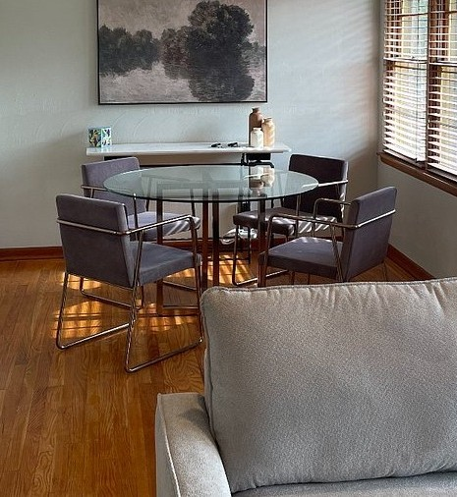
ST. JOSEPH, MICHIGAN
2806 Willa
2806 Willa Drive
1,232 sq. ft. · 2 bedrooms · 1 bath · $2,950 / month
SPACE
Private furnished mid-century brick ranch. Two queen bedrooms, stainless kitchen, on-site laundry, attached garage, patio, AT&T Fiber, and Level 2 EV charging.
NEIGHBORHOOD
Quiet St. Joseph neighborhood. Corewell Health Lakeland, downtown, Lake Michigan, I-94, and the Cook corridor are convenient.
Private home · Garage · Fiber · EV charging · Laundry
$2,950 / month published · confirmed at inquiry
Hollyhock Properties LLC · Southwest Michigan · Equal Housing Opportunity
7 / 13
Notes:
2806 Willa. 2806 Willa Drive. Published FF rate $2,950 / month. Market features, not occupants. Confirm availability before quoting a date.

Slide 8
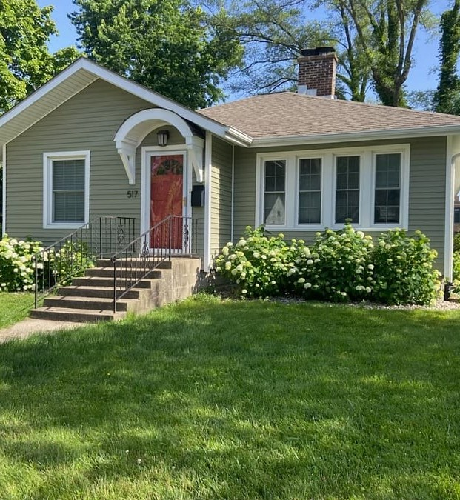
ST. JOSEPH, MICHIGAN
517 Kingsley
517 Kingsley Ave
1,200+ sq. ft. · 2 bedrooms · 1 bath · $3,000 / month
SPACE
Furnished two-bedroom with hardwood floors, fireplace, open kitchen, and a separate family room that can work as an office. Full basement storage and an oversized two-car garage.
NEIGHBORHOOD
Minutes from Corewell Health Lakeland and downtown St. Joseph. Lions Park Beach, Silver Beach, and Lake Michigan are close.
2-car garage · Fireplace · Flex room · Basement · Downtown
$3,000 / month published · confirmed at inquiry
Hollyhock Properties LLC · Southwest Michigan · Equal Housing Opportunity
8 / 13
Notes:
517 Kingsley. 517 Kingsley Ave. Published FF rate $3,000 / month. Market features, not occupants. Confirm availability before quoting a date.

Slide 9
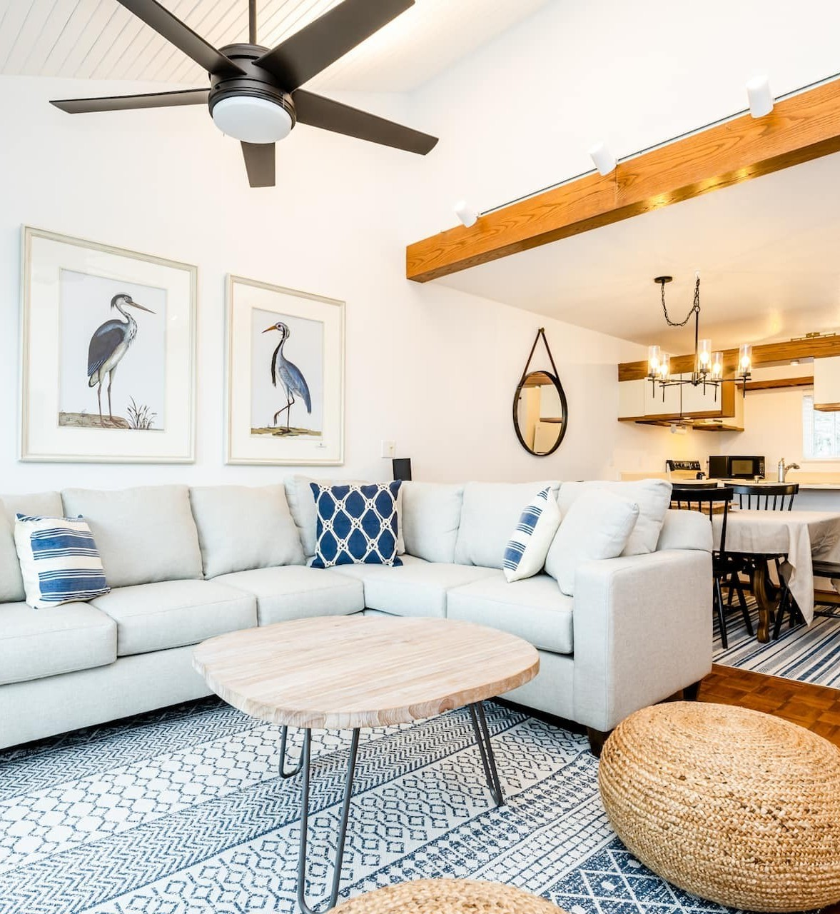
SOUTH HAVEN, MICHIGAN
Harborside
Quaker Square
1,200 sq. ft. · 2 bedrooms · 2 baths · $3,750 / month
SPACE
Furnished two-bedroom, two-bath condo with cathedral ceilings and wall-to-wall sliders to the Black River and marina. In-unit laundry, elevator, secure covered parking, fireplace, and indoor-pool access.
NEIGHBORHOOD
Downtown South Haven, one block from Phoenix Street. South Beach, the lighthouse, and the pier are close. Nine-unit Quaker Square building.
Two baths · River outlook · Elevator · Indoor pool · Covered parking
$3,750 / month published · confirmed at inquiry
Hollyhock Properties LLC · Southwest Michigan · Equal Housing Opportunity
9 / 13
Notes:
Harborside. Quaker Square. Published FF rate $3,750 / month. Market features, not occupants. Confirm availability before quoting a date.

Slide 10
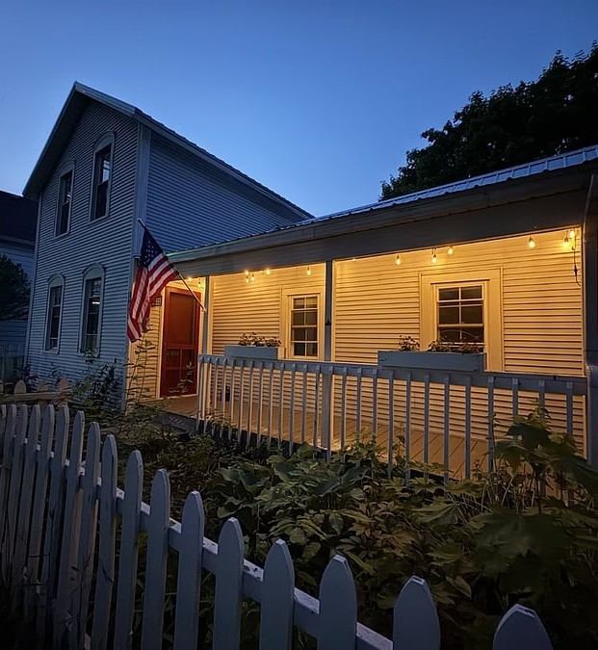
ST. JOSEPH, MICHIGAN
719 Jones
719 Jones Street
1,800+ sq. ft. · 4 bedrooms · 1 bath · $3,200 / month
SPACE
Spacious furnished home with four bedrooms, remodeled kitchen, in-home laundry, private garage, deep driveway, and a fenced yard. Multiple gathering spaces for an extended stay.
NEIGHBORHOOD
Close to downtown St. Joseph, parks, and the waterfront. Silver Beach, Corewell Health Lakeland, I-94, and Amtrak are convenient.
Four bedrooms · Remodeled kitchen · Fenced yard · Garage · Lake access
$3,200 / month published · confirmed at inquiry
Hollyhock Properties LLC · Southwest Michigan · Equal Housing Opportunity
10 / 13
Notes:
719 Jones. 719 Jones Street. Published FF rate $3,200 / month. Market features, not occupants. Confirm availability before quoting a date.

Slide 11
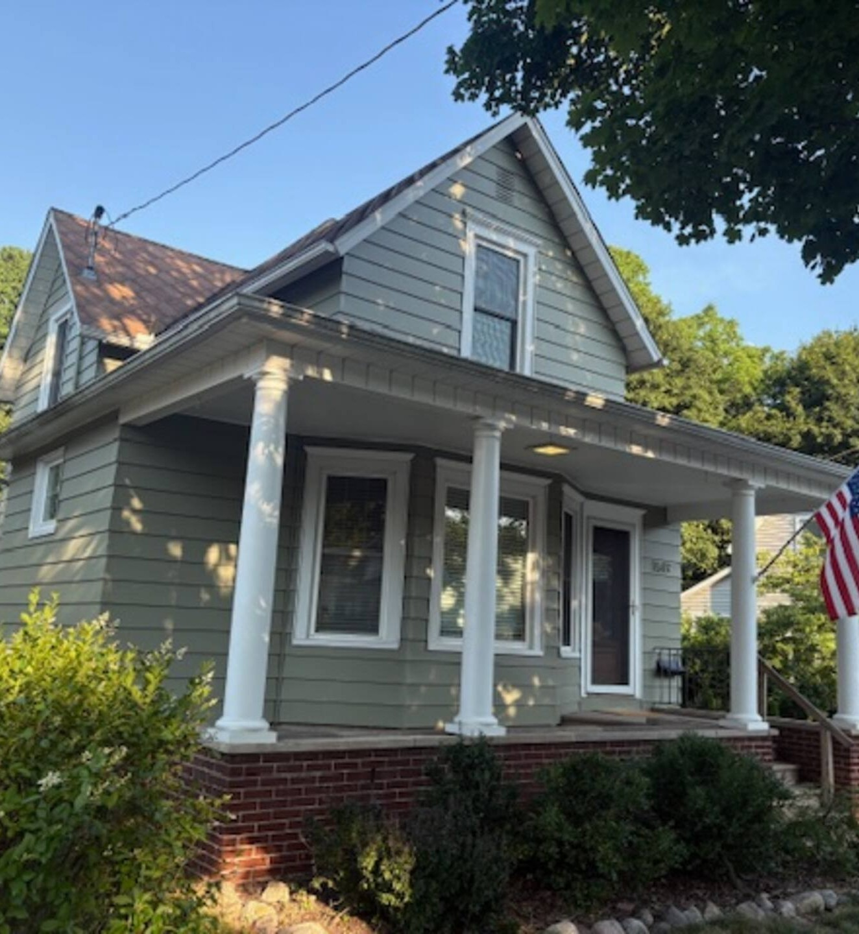
ST. JOSEPH, MICHIGAN
1519 Morton
1519 Morton
2,175+ sq. ft. · 4 bedrooms · 3 baths · $3,800 / month
SPACE
Large furnished home with four bedrooms and three full baths. Separate rear suite with living area, kitchenette, bath, and private deck. Second-floor family room, two laundry areas, ample parking.
NEIGHBORHOOD
Backs up to Kiwanis Park in a walkable St. Joseph neighborhood. Downtown, Silver Beach, and the Lake Michigan shoreline are minutes away.
Rear suite · Three baths · Two living areas · Two laundry · Parking
$3,800 / month published · confirmed at inquiry
Hollyhock Properties LLC · Southwest Michigan · Equal Housing Opportunity
11 / 13
Notes:
1519 Morton. 1519 Morton. Published FF rate $3,800 / month. Market features, not occupants. Confirm availability before quoting a date.

Slide 12
HOW A PLACEMENT WORKS
Four steps. You do not babysit lodging.
01
Call or text the facts
Loss city, occupancy, pets, and a target date. Thirty seconds is enough to start matching.
02
We match from this stack
Willa, Kingsley, Harborside for two bedrooms. Jones and Morton for four. Suite, yard, elevator, garage — we say what fits.
03
Packet in 30 minutes
When inventory matches: options, pricing, and property information. W-9 and lease follow.
04
Stay, extend, return
Monthly terms. Extensions by text if the contractor runs long. One contact through move-out.
Hollyhock Properties LLC · Southwest Michigan · Equal Housing Opportunity
12 / 13
Notes:
Walk the four steps. Emphasize they will not re-book lodging every week. Extensions are a text, not a new search.

Slide 13
Need a home for a policyholder?
Call or text 269-759-8524
hollyhockproperties.com
CLAIM-FRIENDLY
Fast local matching · Monthly stays with extensions · Itemized housing docs · W-9, lease, property info · Direct-bill considered when approved
PROPERTY PROTECTION
Security deposit within Michigan limits · Move-in checklist and photos · Damage beyond normal wear · Cleaning, pet, utility, extension terms stated separately
Hollyhock Properties LLC markets the features of its homes, not preferred occupants. Housing is offered without preference based on protected characteristics and is subject to consistent, objective availability, rental and occupancy criteria.
Hollyhock Properties LLC · Southwest Michigan · Owners are licensed real estate salespersons · Equal Housing Opportunity
Notes:
Close with the number. Leave the pitch sheet. Do not quote a rate until availability is confirmed. Fair housing language stays on this slide — do not delete it.

